Slide 1
Calida
Site Design Review and Land Partition
City of Cornelius Land Use File Nos.
DR-81-22 & LP-01-22

Slide 2
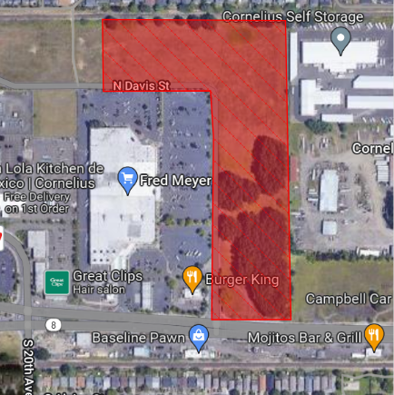
Proposal
The applicant is seeking approval of:
A Type III Site Design Review (DR) for construction of 16 buildings and on-site amenities; and
A Type II 3-Parcel Land Partition (LP) to divide the site into three parcels with dedication of N. Davis Street.

Slide 3
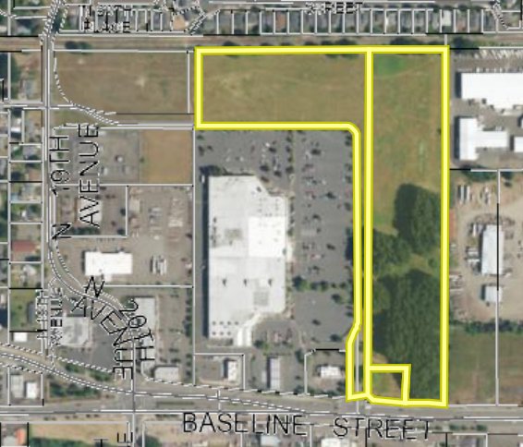
Site
Description
  Site is north of Baseline Street, east of N. Davis Street and west of N. 26th Avenue
  Adjacent to Plaza Los Amigos (PLA)
  Adjacent to Fred Meyer
  Site is generally flat and is vacant of buildings
PLA
FRED MEYER

Slide 4
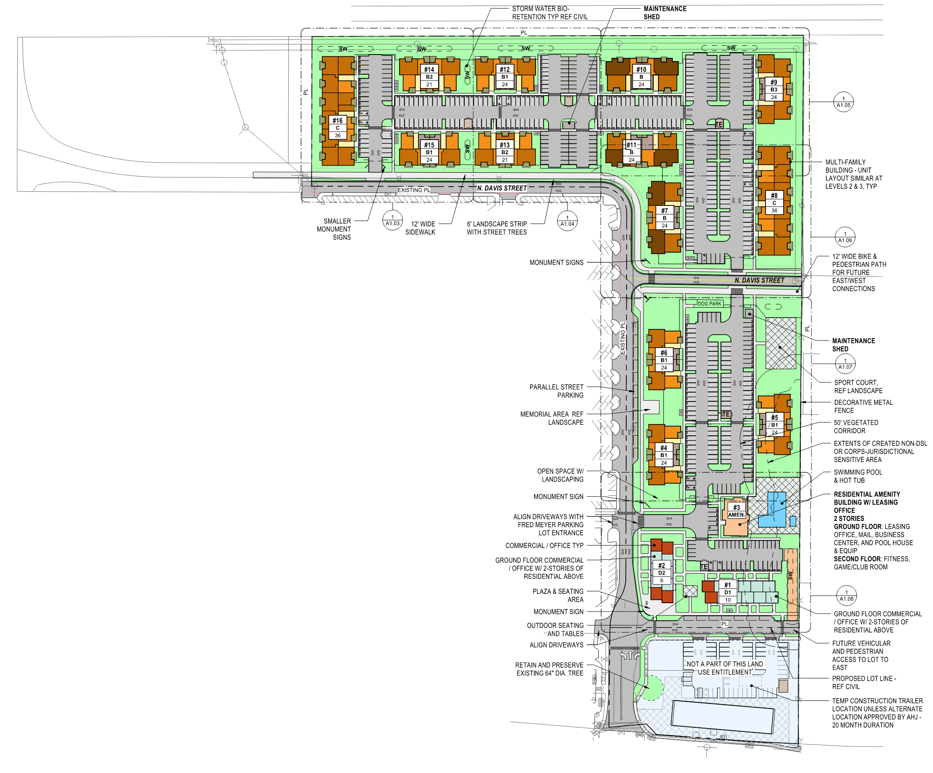
Site Design Review
Mixed-use development with 16 buildings:
  Thirteen 3-story multifamily buildings with 330 apartment units
  One 2-story amenity building
  Two mixed-use 3-story buildings with 16 live-work units and commercial spaces
Extension of N. Davis Street through site
On-site parking areas, landscaping, pedestrian pathways, outdoor dining areas with plaza seating, a dog park, a sport court, and a club house with a pool

Slide 5
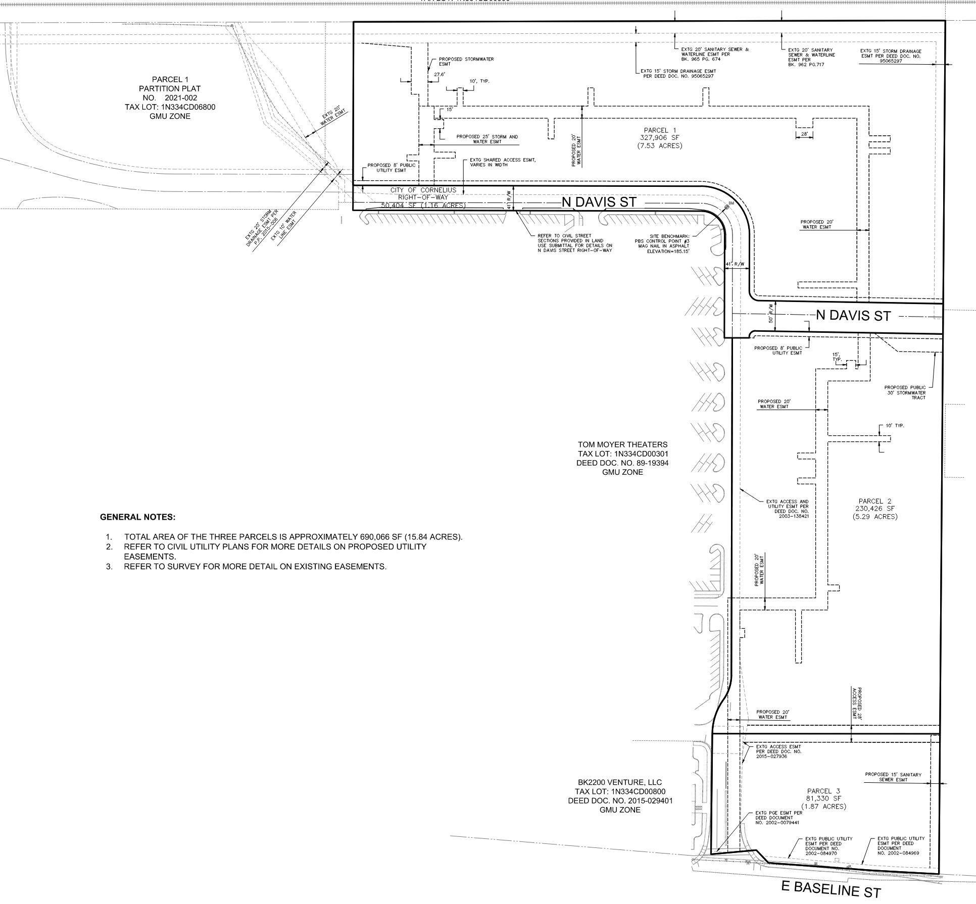
3-Parcel Partition
  Parcel 1: 7.53 acres (10 multi-family buildings)
  Parcel 2: 5.29 acres (3 multi-family buildings, amenities building, 2 commercial/live-work buildings)
Parcel 3: 1.87 acres (no development proposed at this time)
Dedication of N. Davis Street

Slide 6
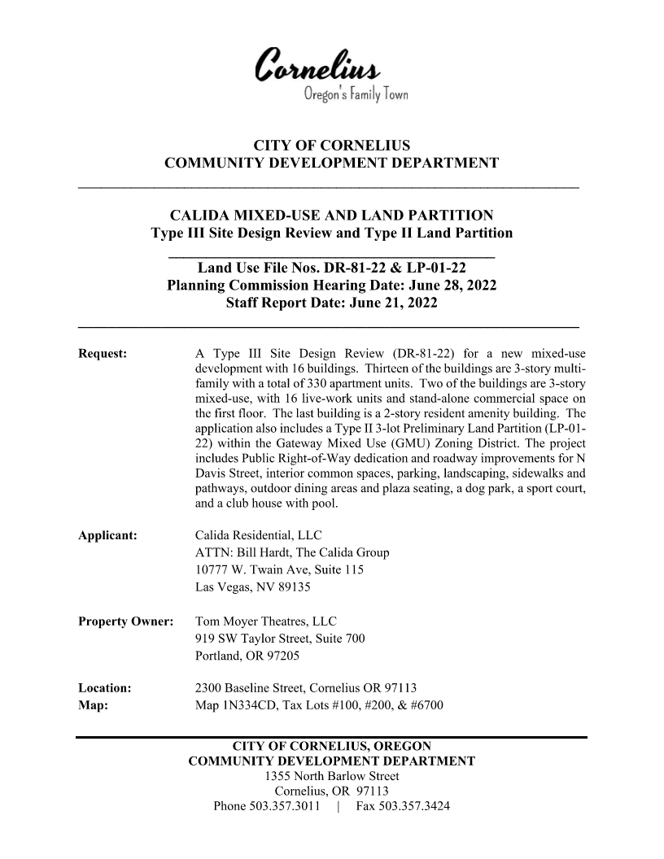
Supporting Documents
Staff Report DR-81-22 & LP-01-22 dated June 21, 2022 with Exhibits

Slide 7
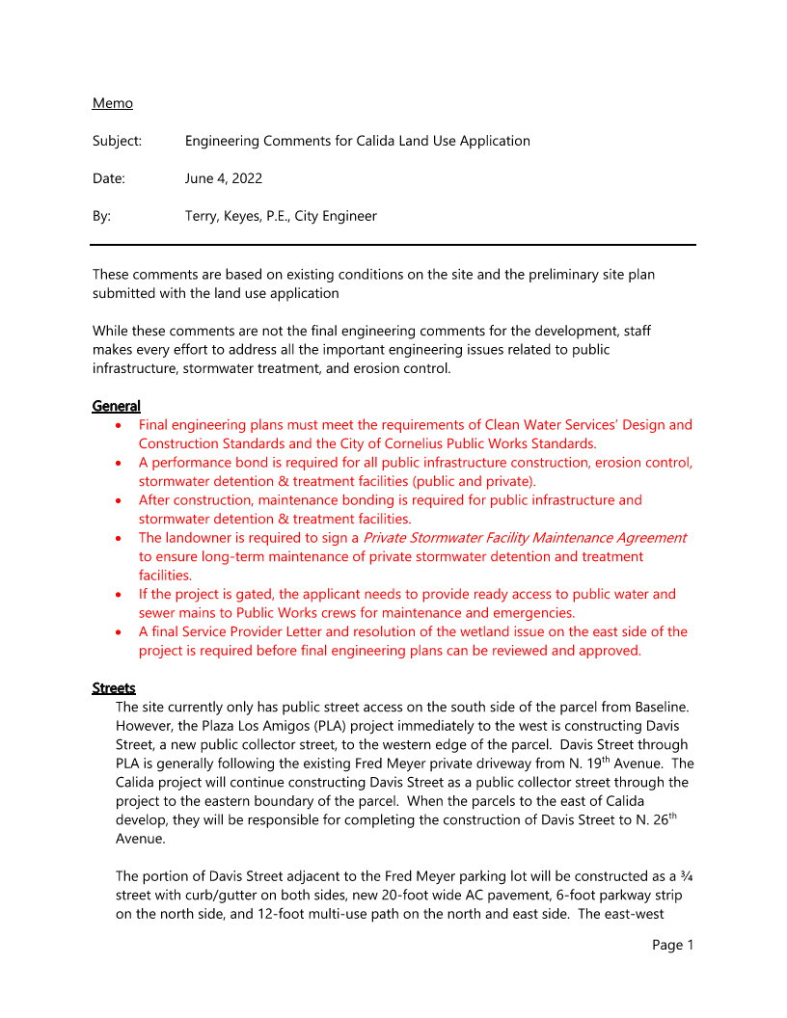
Public and Agency Comments
Agency comments from:
City Engineer (Exhibit C)
Fire Department and Building Official (Integrated into Staff Report)
No public comments received to date
Clean Water Services Service Provider Letter is provisional. A condition of approval requires a final CWS Service Provider Letter prior to final plat is required.

Slide 8
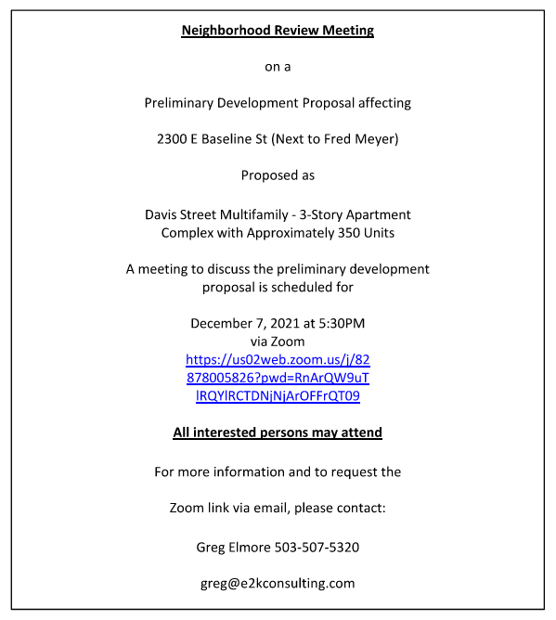
Project Background
Designated as Mixed Use (MU) in Comprehensive Plan
Gateway Mixed-Use (GMU) Zone
Neighborhood meeting, pre-application and public notice requirements have been met
Submittal was deemed complete on May 9, 2022 (120 Days is September 6, 2022)
Notes:
Zoning Map (GMU)

Slide 9
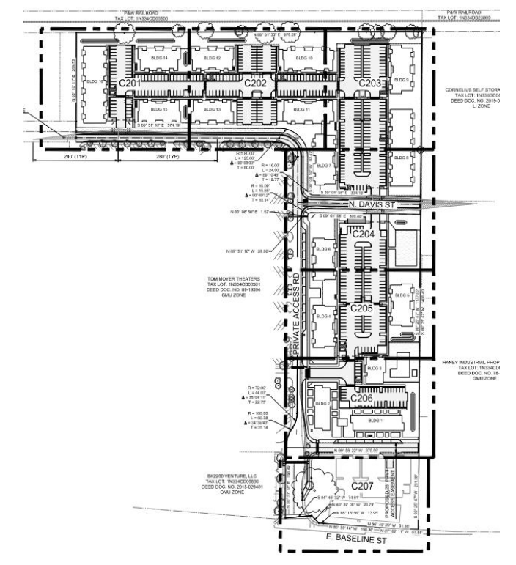
Project Layout
Improve N. Davis Street through site
Sidewalks & street trees
Water, sewer, and storm water system
New landscaping
Parking and circulation throughout site, with private access easement along western property boundary connecting N. Davis Street to Baseline Street.
Notes:
Site Plan-utilities

Slide 10
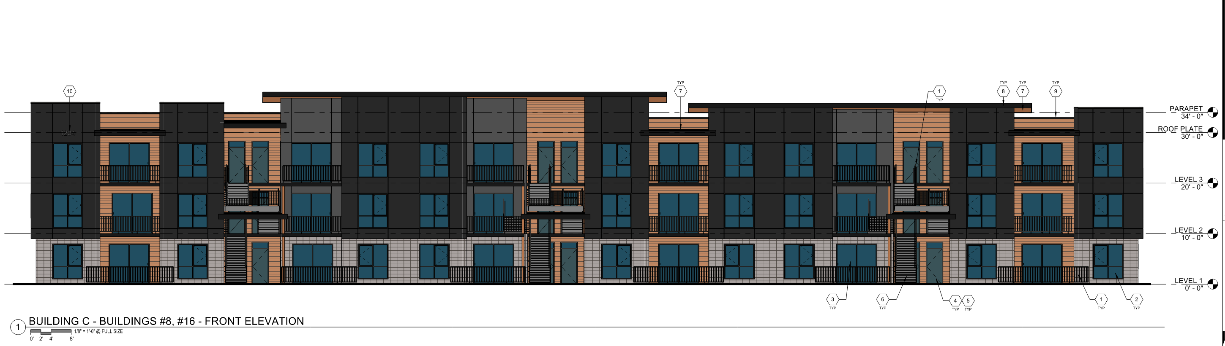
General Design
Three-story structures (except amenities building, which is two-story)
Neutral earth tones, Northwest Design
Varied materials to differentiate lower and uppermost levels
Largest building (multi-family) front elevation:
Notes:
Elevations, description

Slide 11
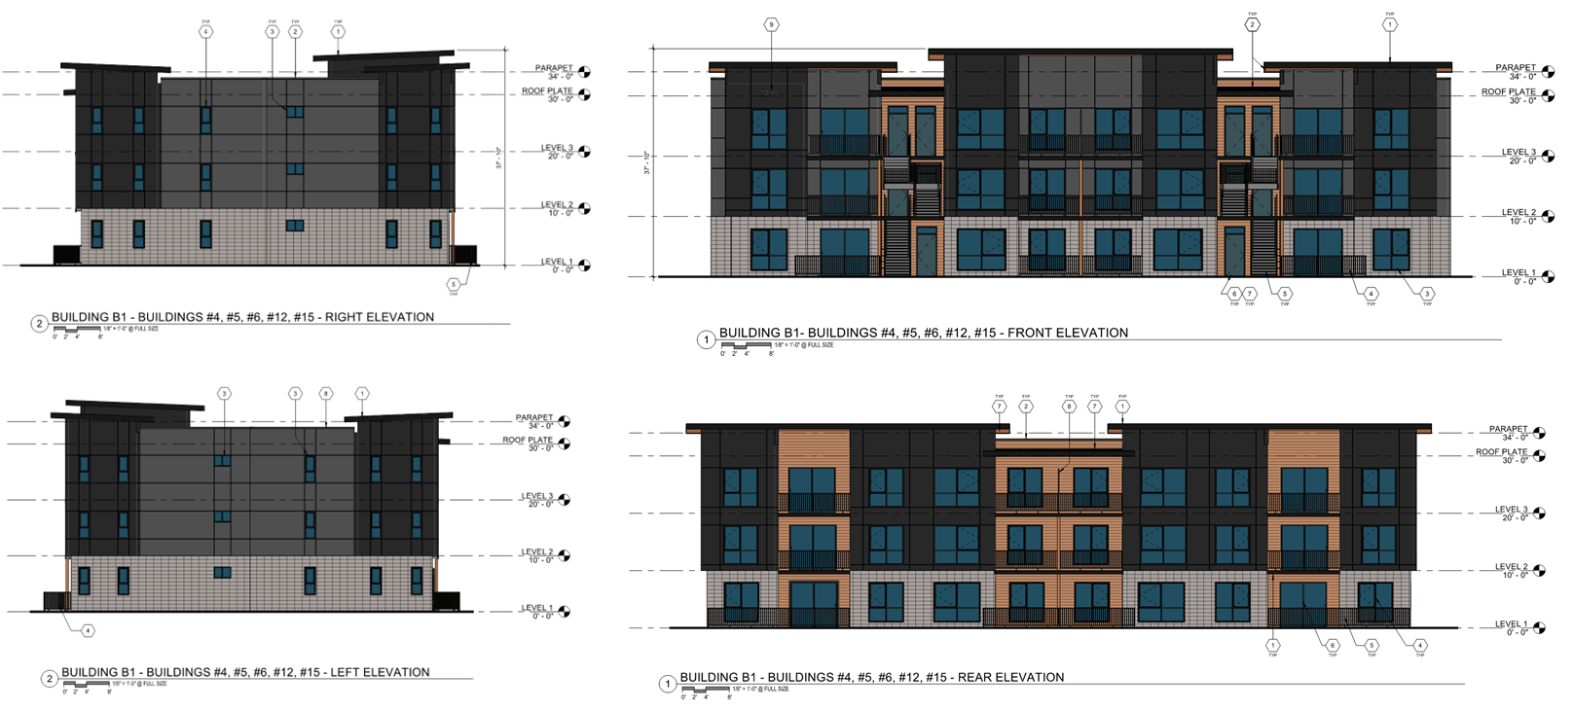
General Design- Multi-Family

Slide 12
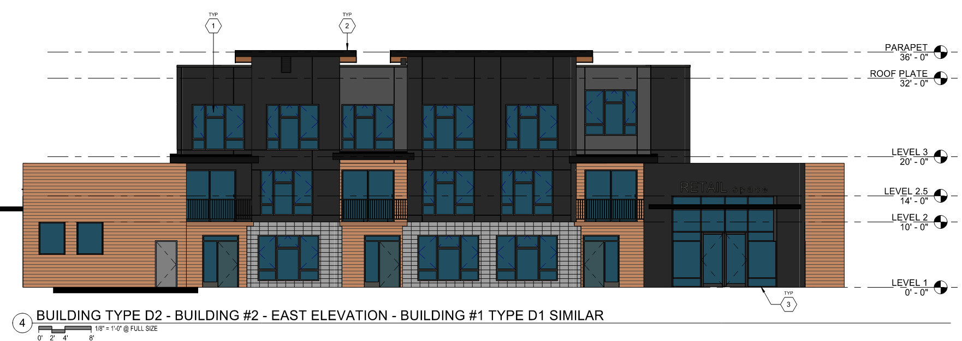
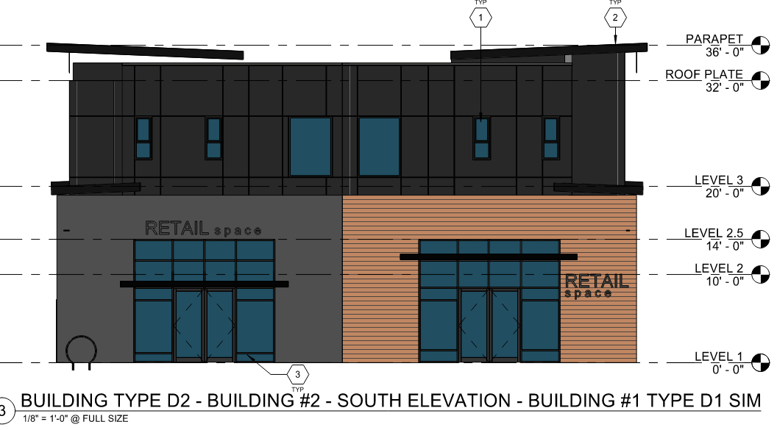
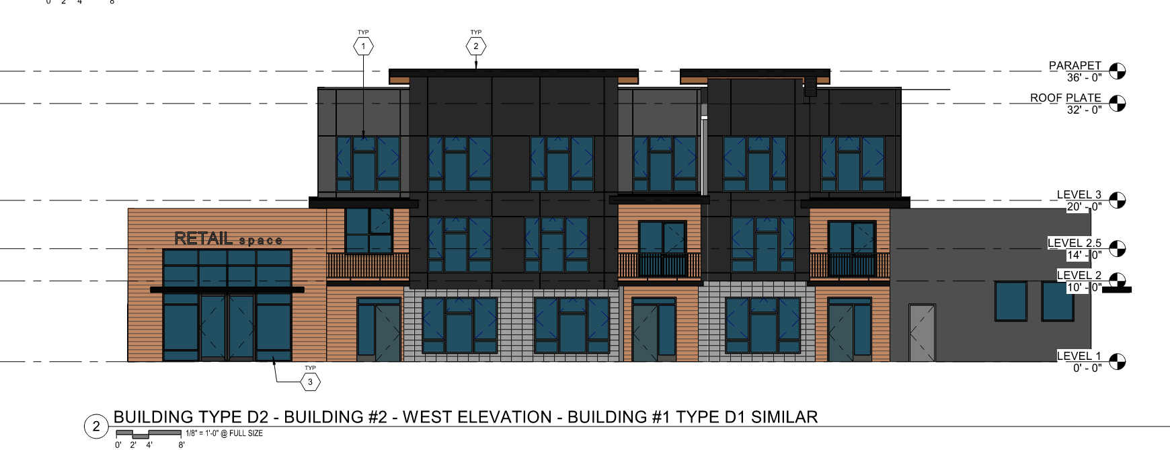
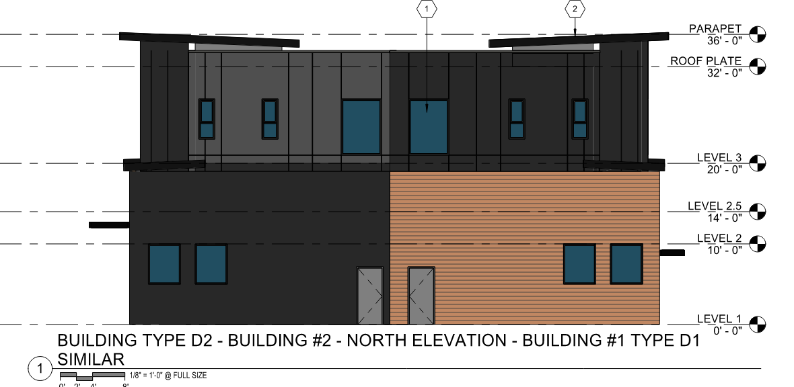
General Design- Mixed-Use

Slide 13
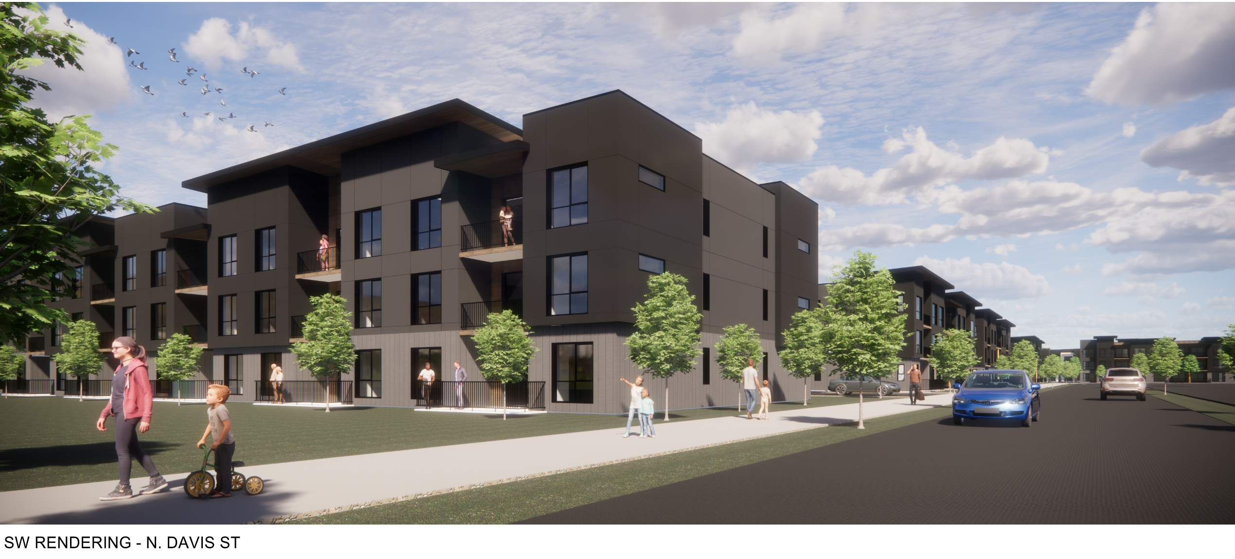
Type III Site Design Review and Type II Land Partition Standards
Meets Development Code and Public Works Standards as proposed or with recommended conditions of approval as identified in the staff report.

Slide 14
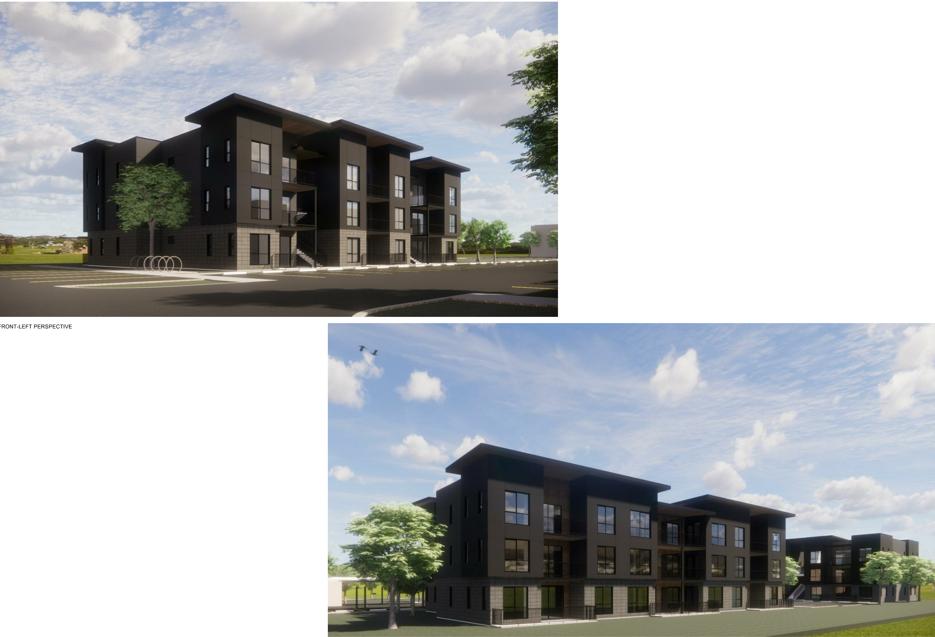
Type III Site Design Review and Type II Land Partition Standards
As proposed and with CoA’s, conformance with the base zone GMU standards, CMC 18.100 Site Design Review standards and CMC 17.05 Land Divisions standards can be met.
Based upon the proposal, the minimum applicable CMC requirements can be met.

Slide 15
Key Recommended Conditions of Approval
Prior to Building Permit Submittal
The Preliminary Land Partition Plat, as approved via LP-01-22, with Final Plat approval by the Community Development Director, shall be recorded with Washington County.
A Final CWS Service Provider Letter and resolution of the wetland issue on the east side of the project is required before final plat and before final engineering plans can be reviewed and approved.

Slide 16
Key Recommended Conditions of Approval
Prior to Building Permit Submittal (cont’d.)
The Applicant shall submit a final site plan for review and approval to the Planning Department identifying:
The widened drive aisles needed for fire apparatus access (per Exhibit D);
A revised vehicle parking plan showing a maximum of 126 compact spaces; and
A minimum of 90 long-term and 90 short-term bicycle parking spaces.
The Applicant shall provide documentation to guarantee the perpetuation of the ground-floor commercial uses on Parcel 2 in the live-work units, such as a deed restriction on Parcel 2 of the proposed partition plat requiring a minimum of 50% ground floor commercial development.

Slide 17
Key Recommended Conditions of Approval
Prior to Building Permit Submittal (cont’d.)
The Applicant shall submit final engineering plans for review and approval to the City Engineer meeting the requirements of Clean Water Services’ (CWS) Design and Construction Standards and the City of Cornelius Public Works Standards and including additional right-of-way dedication for N. Davis Street west of the site.
Building permits, including a geotechnical report, shall be submitted to City Forest Grove’s Building Department for review on behalf of City of Cornelius.

Slide 18
Key Recommended Conditions of Approval
Prior to Site Development
The Applicant must obtain grading and erosion control permits, Final Engineering Plan approval and Final Site Plan approval.
The Applicant shall obtain an approved Erosion Control permit 1200-C from CWS.

Slide 19
Key Recommended Conditions of Approval
Prior to Building Permit Issuance
The Applicant shall pay the TDT determined by the City, as necessary.
The applicant shall obtain all the appropriate Building, Plumbing, Electrical, and Mechanical Permits and shall meet all applicable Building Code requirements for the proposed development.
The applicant shall submit a swimming pool permit per Cornelius Municipal Code 15.15.

Slide 20
Recommendation
The Community Development Department recommends approval of the Type III Site Design Review and Type II Land Partition application (DR-81-22 & LP-01-22) for a new 16-building multi-family and mixed-use development and land partition, subject to the recommended conditions of approval.
A new multi-family and mixed-use development and associated facilities as shown and described within DR-81-22 & LP-01-22.

Slide 21
